Slide 1
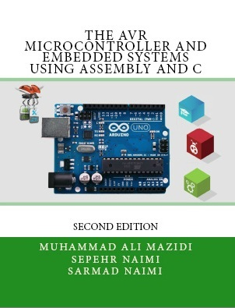

Introduction to AVR
Chapter 1
Sepehr Naimi
www.NicerLand.com

Slide 2
Topics
Microcontrollers vs. Microprocessors
Most common microcontrollers
AVR Features
AVR members

Slide 3
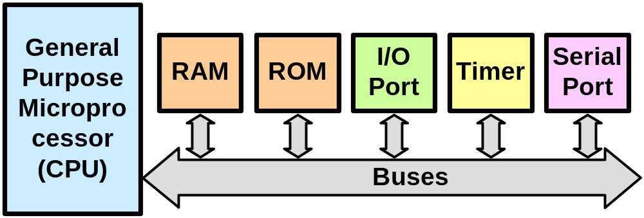
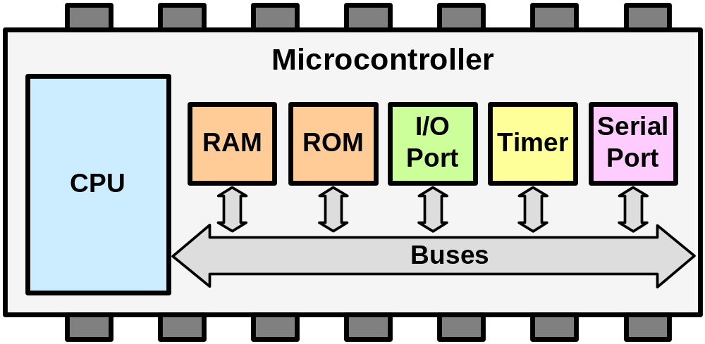
General Purpose Microprocessors vs. Microcontrollers
General Purpose Microprocessors
Microcontrollers

Slide 4


Most common microcontrollers
8-bit microcontrollers
  AVR
  PIC
  HCS12
  8051
32-bit microcontrollers
  ARM
  AVR32
  PIC32

Slide 5
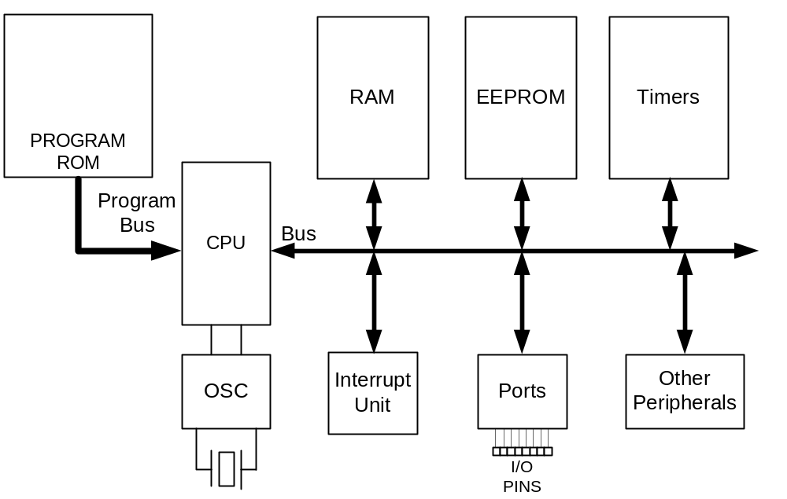
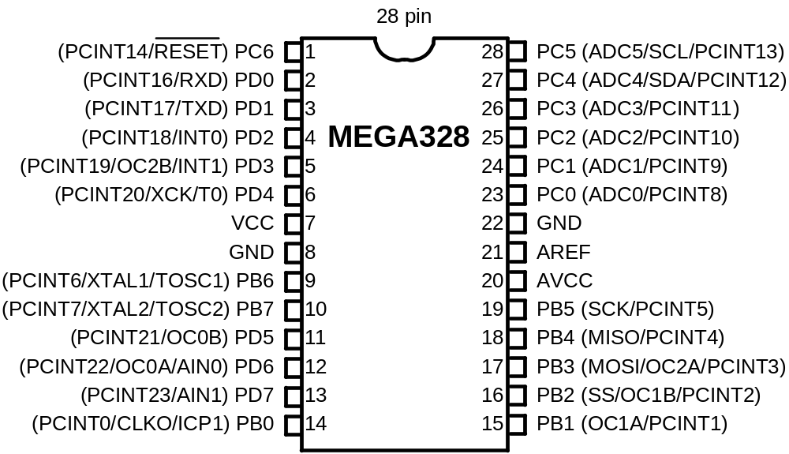
AVR internal architecture

Slide 6
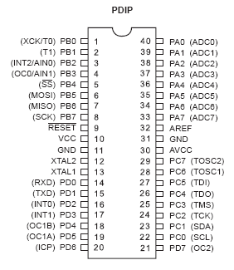
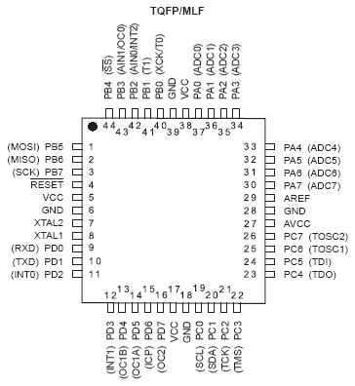
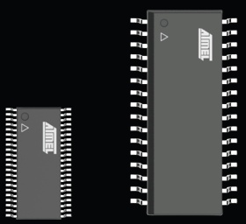
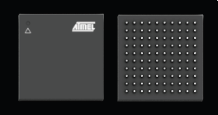
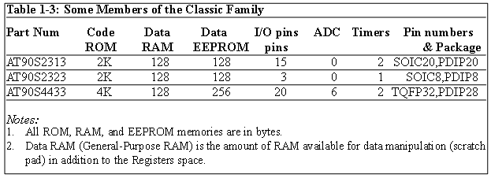
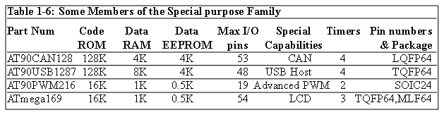
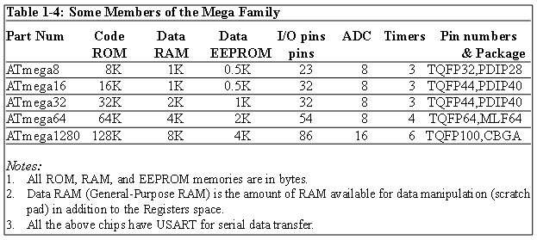
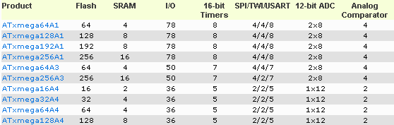
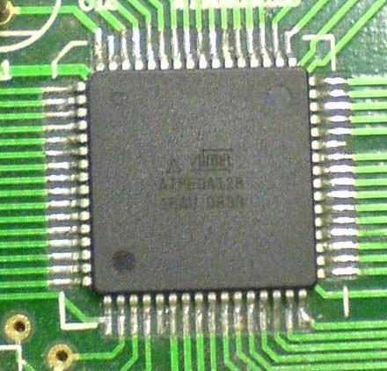
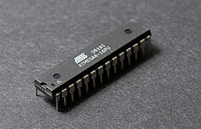
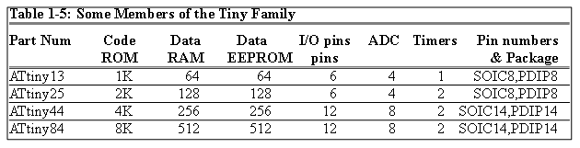
AVR different groups
Classic AVR
  e.g. AT90S2313, AT90S4433
Mega
  e.g. ATmega328, ATmega32, ATmega128
Tiny
  e.g. ATtiny13, ATtiny25
Special Purpose AVR
  e.g. AT90PWM216,AT90USB1287
XMega
  New features like DMA, DAC, crypto engine, etc.
CBGA
TSSOP
SOIC

Slide 7
Let’s get familiar with the AVR part numbers
ATmega128
Atmel
group
Flash =128K
ATtiny44
AT90S4433
Atmel
Tiny group
Flash =4K
Atmel
Classic group
Flash =4K

